Slide 1
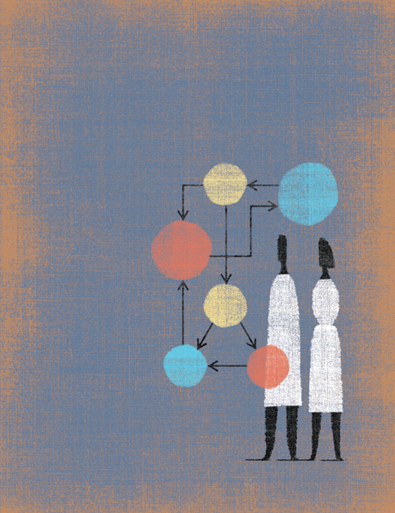
Mapping: Taking a look at Current State, and Creating a Better Future State
Margie Wiebe, BScN, PCCN
Primary Health Care Developer (NH) Quesnel
T: 250.983.6816
Email: margie.wiebe@northernhealth.ca
Willis, D.R., (2005)
Notes:
1

Slide 2
Learning objectives - mapping
Our LAT aim in mapping
Why we use process mapping & what a process is
How to create a current state process map
What process mapping looks like from a customers point of view (patient journey mapping)
Analyze our current state through value and non value analysis
How to create a future state map & make high impact changes

Slide 3
Overall Mapping Aim
To understand our current state (suicidal response process for children and youth) and design improved integrated future state
We start by creating current process maps at key organizations
  ER & inpatient
  MCFD (CYMH, protection services, disability )
  RCMP
  Schools
Create a current state patient journey map
Then analyze current state maps using value stream mapping
We end by creating improved future state maps (protocols)

Slide 4
Why Map a Process
Highly visual tool to see all steps of a current process
Current state process map is baseline for improvements
It is a powerful tool to help plan high impact changes
It is a simple exercise; useful to solve particular process problems (“aha moments”)
Once mapped, the bottlenecks, time delays, duplicates, handoffs, value added and non value added steps… “jump right out”
Notes:
4

Slide 5
What is a Process?
A process is a series of connected steps or actions that achieve an outcome
A process has a starting point and end point
One process is usually linked with other processes in other systems
It has a defined group of users (ie youth with suicidal ideation)
Has a purpose or aim (crisis response to suicidality)
Notes:
5

Slide 6
What is Process Mapping
“A process map is essentially a breakdown of a (all the steps in a) process to determine how it flows and, ultimately, how effective it is.” Chron.com

Slide 7
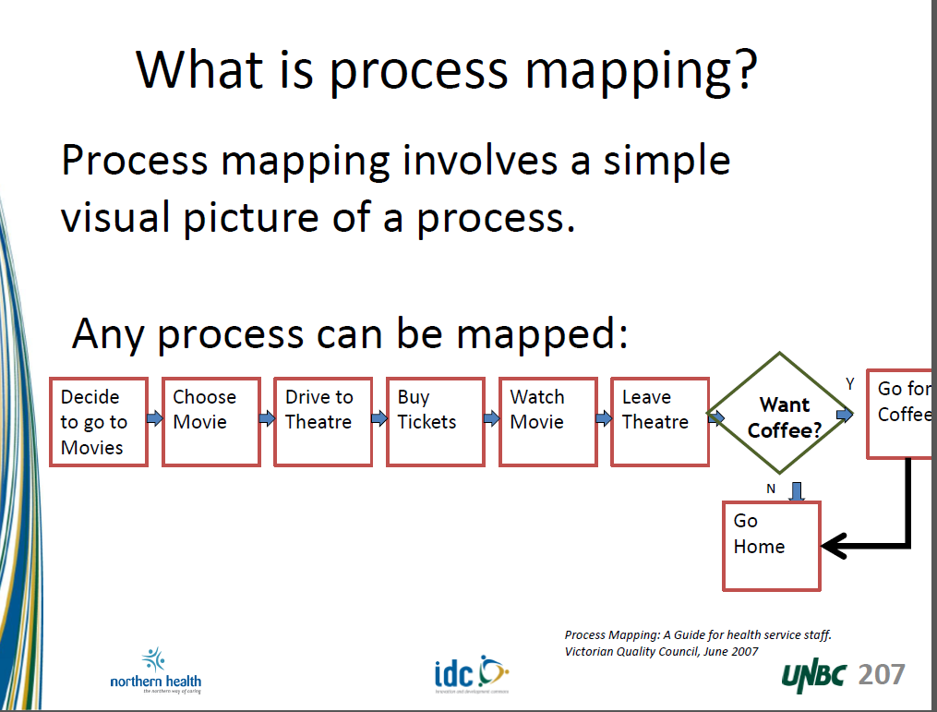
Process Mapping:
Understanding the flow or sequence of events
Conventional symbols represent different activities:
Oval - the start and end of the process
Box - the tasks or activities of the process
Diamond - a question is asked; a decision is required
Arrow - the direction or flow of the process
Notes:
7

Slide 8
Steps in Process Mapping
Define what to map
Define a start and end point (scope)
Try to capture every step in the process
Map only what is currently is done
Map what happens 80% of the time
Honesty is key
No blame or judgement is also key

Slide 9
Mapping Symbols
= start or end point
= direction of the flow
= step in the process
= a decision
☺ = value added as defined by customer
☹ = non value added but required or law
☹ = non value added

Slide 10
Example of the high level process for referring a student to MCFD (CYMH)
Child with behavioural problems
Parent notified
Parent teacher meeting
Doctor assessment
Screened for learning disabilities
Confidentiality forms
CYMH referral req
CYMH calls parent
Pt seen at CYMH
Modified from Langley et al, (2009) Improvement Guide, p. 37
Notes:
A process has a flow

Slide 11
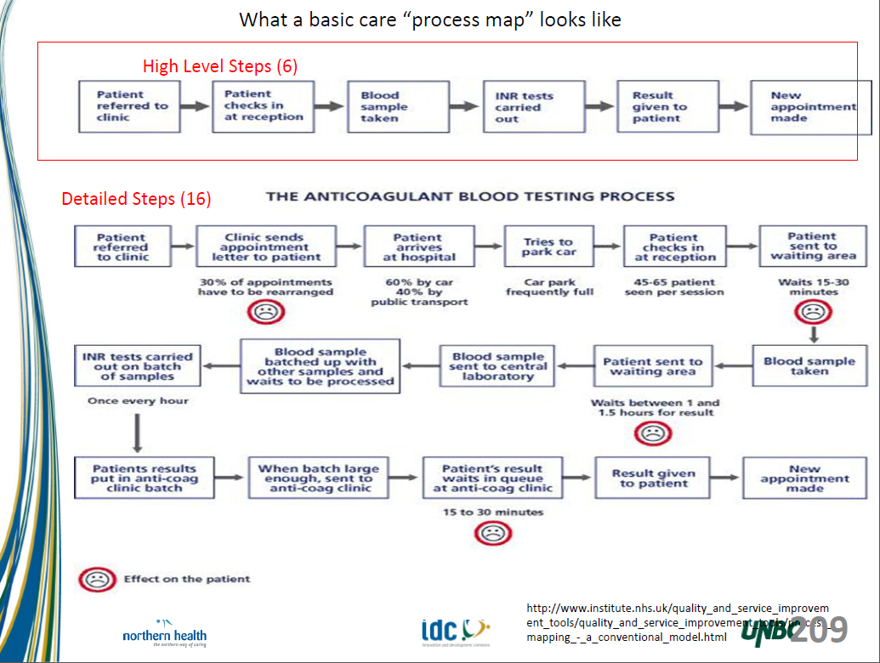

Slide 12
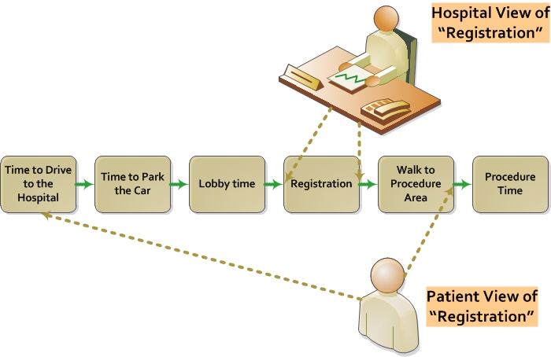
Customer’s Perspective
Notes:
Now, when we are determining value, LEAN methodology invites us to consider our work from the customer’s perspective (aka, client/patient)
This is important, because it is ultimately the customer who will determine whether something is valuable or not, and it is the customer/patient/client who we are being paid to serve
As healthcare providers, we may have certain perceptions of our services. For example, we may conceive of “registration” in a hospital to be a particular location.
However, from the patient’s perspective, the task of registering in our health system also involves other steps, such as driving to a facility, parking the car, finding your way to the registration area, finally getting registered, then going to the procedure area.
Conceiving processes in this way also helps us see how complex things can be, and how we might need to “scope” a quality improvement project (e.g., limit the amount of things we are going to try to improve so that we don’t overwhelm ourselves).
Lastly, it is noteworthy to point out that there are many customers in a system.
Potential Question to Audience: Who are some of your customers in your work?
12

Slide 13
Parallel processes
Example: generate a referral letter and get appointment details to patient
Parallel processes often are the cause of delays for patients and frustration for staff
Mapping, analyzing and improving parallel processes will deliver great benefits
Separate the parallel process from the patient process (e.g. map with different color)
Map the parallel process alongside, but separate from the patient process (see p. 20 in NHS process mapping)
GP tells patient they need a hosp. appt
GP dictates referral letter
Patient waits
Hospital appoint-ment clerk posts letter to patient
Patient receives appt

Slide 14
Hand-offs
  Up to 50% of steps involve a “hand-off” (NHS)
  90% of errors, duplication, delays in a journey occur at the point when the patient or paper work is handed from one person, department or organization to another (NHS)
Notes:
Around 90% of the errors, duplication and delay in patient processes are at the point of “hand-off” – where responsibility for the patient is handed from one professional or department or agency to another. Up to 50% of the steps in a typical patient process involve a “hand-off”

Slide 15
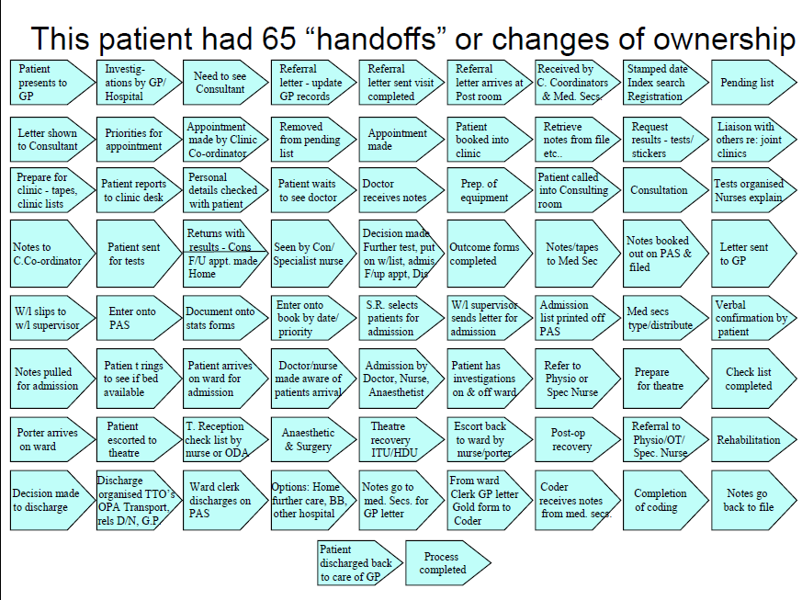
Taken from NHS slide deck

Slide 16
How do we improve current state?
Value stream mapping
Root cause analysis for BIG problems

Slide 17
Value Stream Mapping
Determine Value from the Customers perspective
Value is:
What the patient/client would be willing to pay for
Something that improves service in some way
Something that is done right the first time
Is the activity valuable to the patient? = Value Added
Is the activity waste? = Non-Value-Added

Slide 18
Defining Value
Value added: Make direct contribution to what the customer values
Non value added but essential: required to allow value added steps to occur or by law
Non value added: Everything else

Slide 19
Example of defining value in ER
Value added: Make direct contribution to what the customer values | Procedure Pt. interaction
Non value added but essential: required to allow value added steps to occur or by law or regulations | Registration Triage Lab test processing
Non value added: Everything else | Wait

Slide 20
Value stream
3 hrs 3 days
Opportunity time: all non value added time = 75hrs
Value added time: all value added and required = 4hrs 20 mins
Lead time: Non value + value added 79hrs 20 minutes
Registration 20 mins
Assessment 1 hour
transferred to safe care 3hours

Slide 21
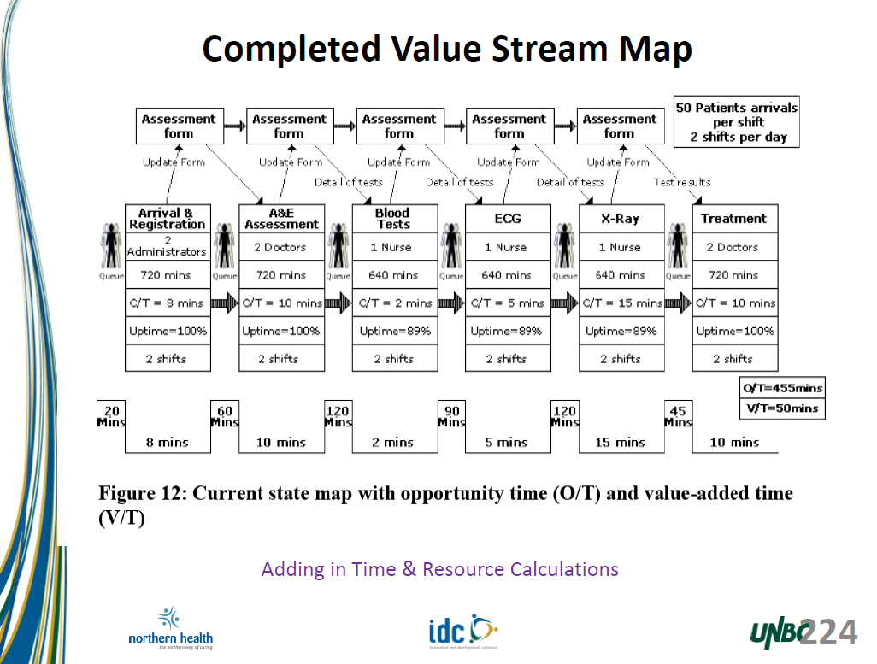

Slide 22
Future state map
Review Hot spots on the value stream map
  non value added
  hand offs
  Opportunity times – especially wait times
Root cause analysis for each BIG problem
  ask why 5 times this will get to the root of the problem
  Then think of pdsa change ideas …for what is at the root of each problem area

Slide 23
Summary
We map to visually see each step of our current state
We analyze our current state
  Asking, “ is this a value added step to customer?”
  Calculate value and opportunity (non value) time
  Determine root causes of BIG problems with 5 whys
We create a future state:
  Reduce hand-offs
  Design value added processes

Slide 24
Glossary
Value added: Define value from the customers perspective, actually adds value to the patients journey
Value Stream: map all the steps, value added and non value added, that bring service/product to the customer
Perfection: the complete elimination of waste so all activities create value for the customer
Backlog: Previous demand that has not yet been dealt with, showing itself as a queue or waiting time
Queue: Work waiting to be done at a given point, patients waiting to be seen or wait list for procedures/treatments
Hand-off: When a patient is passed on from one health care provider to another
Parallel process: Different activities that take place in the same time period
Constraint: The actual cause of the bottleneck, usually a necessary skill or piece of equipment
Bottleneck: Part of the system where patient flow is obstructed, causing waits and delays
Lead time: The time it takes for a patient to move all the way through a process
Batching: Piling up a type of work as it comes in until a later time when all this type of work is done together
NHS leaders guide process mapping, analysis, and redesign p. 30

Slide 25
Resources
NHS Institute for Innovation and Improvement, (2010) Process Mapping, Analysis, and redesign. http://www.institute.nhs.uk/index.php?option=com_joomcart&Itemid=194&main_page=document_product_info&cPath=65&products_id=295
Impact BC (Nov 26, 2009) a step by step presentation on mapping http://www.impactbc.ca/learningseries/resources/secondcohort
Willis, D. (2005) Making Every Minute Count http://www.aafp.org/fpm/20050400/61maki.html

Slide 26
Resources
Garret, D.V. (2007) Quick ways to maximize your office practice, AAFP. P. 32-34 http://www.aafp.org/fpm/2007/0900/p32.pdf
Willis, D.R. (2005) Making every minute count: tools to improve office efficiency. AAFP, p.61-66. http://www.aafp.org/fpm/2005/0400/p61.html
NHS leaders Guide For Mapping:
  http://www.institute.nhs.uk/option,com_joomcart/Itemid,26/main_page,document_product_info/products_id,295.html
NHS 10 High Impact Changes leaders Guides:
  http://www.institute.nhs.uk/index.php?option=com_joomcart&Itemid=194&main_page=document_product_info&products_id=213
NHS information on improvement mapping:
  http://www.tin.nhs.uk/index.asp?pgid=1179
Mercey care NHS process mapping:
    http://www.merseycare.nhs.uk/services/corporate/sdt/Process_mapping.asp
National Managers Tools:
  http://www.managers-gestionnaires.gc.ca/documents/chartier/toolkit_e.pdf
Notes:
26

