Slide 1
Local Action Team
Patient Journey Mapping
April 7, 2016

Slide 2
Purpose of the Collaborative
Introductions
  Who are you?
  Where are you from?
  What do you want out of the day?
Purpose of Patient Journey Mapping

Slide 3
Purpose of the Collaborative
Increase the number of children and youth (0-25 years old) and families seeking and receiving timely access to integrated, mental health and substance use services and supports
Document examples and results of the involvement of children, youth and families in decisions related to program and system design, clinical practice and policy development

Slide 4
Ground Rules
Create and Hold Safe Space
  Open
  Curious
  Respectful
  Courageous
  Forward looking
  No blame
Confidential – experiences stay in room; learning goes forward

Slide 5
Overview of Our Mapping
Stage 1: Welcome, Introductions and Preamble – 20 minutes
Stage 2: Journey Mapping – 100 minutes
Dinner – 30 minutes
Stage 3: Reflections and Generating Solutions – 45 minutes
Stage 4: Validation with youth and families – 30 minutes
Stage 5: Final Wrap Up – 15 minutes
Stage 6: Future Action

Slide 6
Stage 2: Patient Journey Mapping
[*] journey – identify barriers and ideas
Youth and families’ journey – identify barriers and ideas
Facilitator's role
Recorder’s role
Safe space

Slide 7
Listening For and Identifying Barriers
What was the experience of the youth accessing supports and services
What was the experience of the family?
What were the challenges
What worked well?
What were the wait times for transitions, service provision?
Ideas for improvement from youth and families?
How might the system be improved?
  Ineffective experiences or “misses” where support could have been provided
  Times where resources, supports could have positively impacted the youth and family
  What worked well that we can spread?

Slide 8
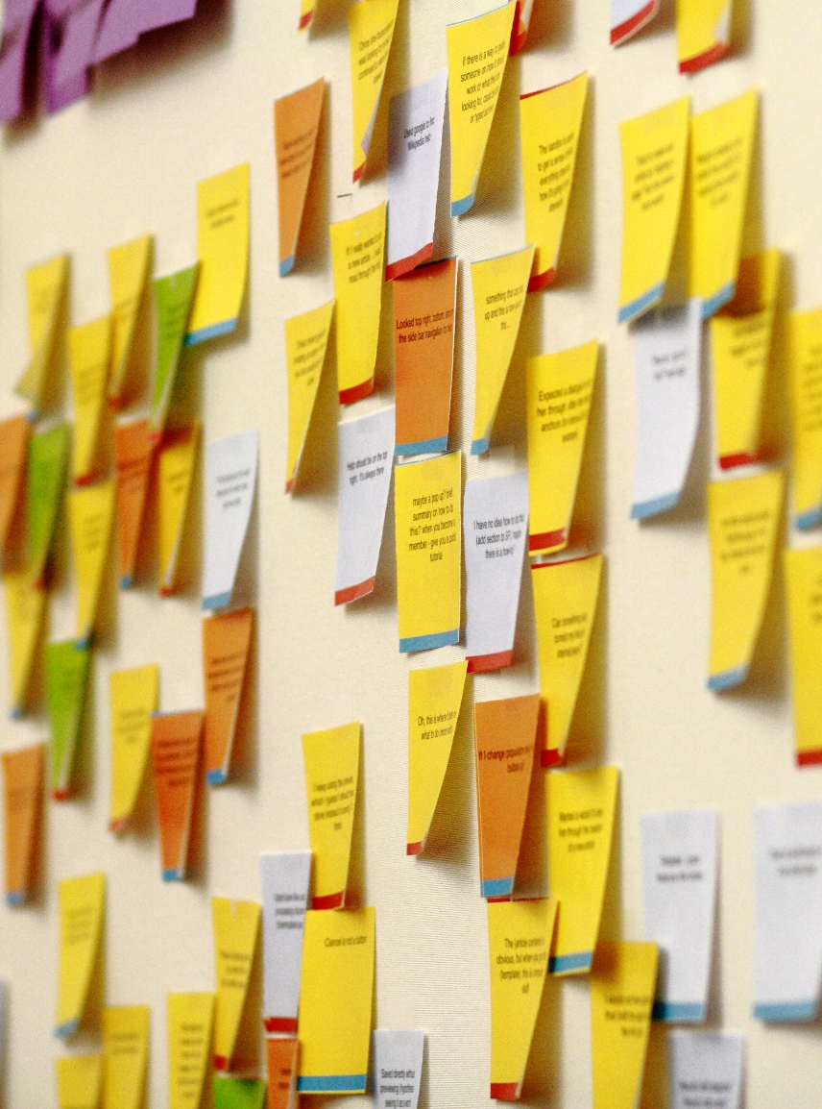
Barriers
Ideas
For both composite case and experiences of youth and family

Slide 9
*’s Journey: Ages 5 - 6
Composite case narrative

Slide 10
*’s Journey: Ages 7-12
Composite case narrative

Slide 11
*’s Journey: Ages 12 - 13
Composite case narrative

Slide 12
*’s Journey: Ages 13 - 15
Composite case narrative

Slide 13
*’s Journey: Ages 15 -16
Composite case narrative

Slide 14
*’s Journey: Ages 15 -16 con’t
Composite case narrative

Slide 15
*’s Journey: Ages 16 - 17
Composite case narrative

Slide 16
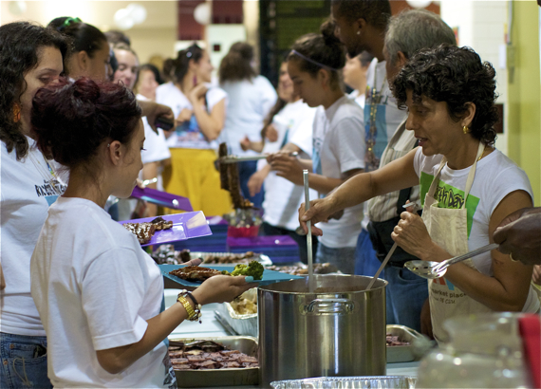
Dinner

Slide 17
Stage 3: Reflection and Generating Solutions
What are the themes arising from the Barriers?
Ideas:
    What did we hear youth and family say would be helpful?
    What are we curious about trying?
    What can we test next week or month at the local level?

Slide 18
Stage 4: Validation with Youth and Families
Did we listen well enough?
Did we miss anything?
Do you want to add anything?

Slide 19
Stage 5: Final Wrap Up
One word to describe how the evening has been for you?

