Slide 1
Fentanyl on Campus
An overview of the VOICe Campus Health (and friends!) Approach to reducing risk at UBC Okanagan

Slide 2
The Plan
Introductions
Overview of the issue – Melissa Feddersen (VOICE Campus Health Project)
Prevention Plan – Nursing student team
Harm Reduction Plan – Update from Jean Bryans (Health and Wellness)
Policy Ask – Michelle Thiessen (Canadian Students for Responsible Drug Policy)
Discussion

Slide 3
What is Fentanyl?
Fentanyl is one of a class of drugs called “opioids,” drugs that bind to receptors in our brain and alter our perceptions of pain. There are many different opioids, including prescription drugs like codeine (e.g. Tylenol 3), hydomorphone (e.g. Dilaudid), and oxycodone (e.g. Percocet). When prescribed, they are often used after surgery or for moderate-to-severe pain treatment.
Some opioids that are available by prescription or used in hospitals (e.g. fentanyl, heroin) are also manufactured in illicit labs or ‘kitchens’ (by people with varying degrees of competence). These unauthorized drugs can be made to look like prescription drugs or sold as street drugs, like cocaine or MDMA.
(Healthy Minds, Healthy Campus Fentanyl FAQ, 2016)

Slide 4
The problem
In British Columbia:
There were 555 apparent illicit drug overdose deaths from Jan to Sep 2016. This is a 60.9% increase over the number of death occurring during the same period in 2015 (345). (BC Coroner, August 2016)
Preliminary data for Jan – Aug 31, 2016, suggest that the proportion of illicit drug overdose deaths for which fentanyl was detected (alone or in combination with other drugs) increased to approximately 61% in 2016 from 30% in 2015.
As of September 21, we have exceeded a record breaking 2015 with 555 deaths (508 in all of 2015).
In Kelowna:
18 people have died of OD in Kelowna between January – August 2016. 6 died all of 2015.

Slide 5
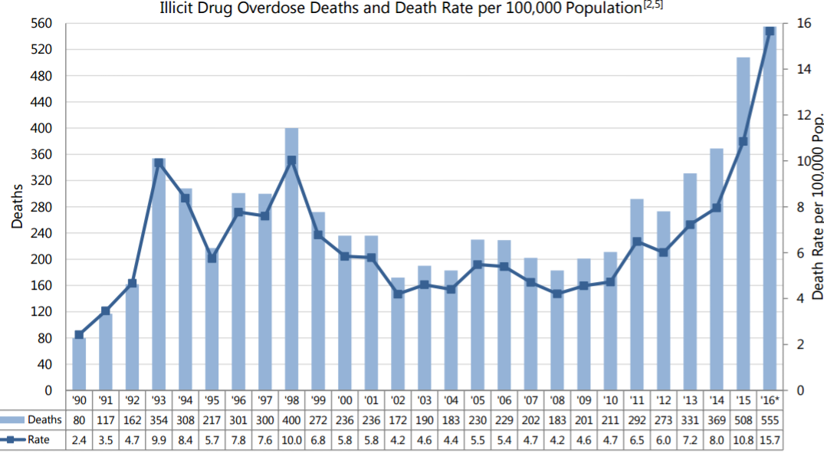

Slide 6
The issue is not opiate addiction…
A sample review of toxicological findings for 207 fentanyl-detected illicit drug overdose deaths in 2016 was conducted. In 96% of these deaths, at least one substance other than fentanyl was detected. The four most frequently detected drugs were as follows:
cocaine (46% of deaths)
ethyl alcohol (36% of deaths)
methamphetamine (34% of deaths)
heroin (30% of deaths)
(Source BC Coroner, Up to August 31, 2016)
Fentanyl has also been found in oxycodone (percocet), MDMA, ecstasy. There has been anecdotal evidence that there has even been marijuana tainted.

Slide 7
SO why are our students so at risk?
Regular opiate users develop tolerance over time. Most recreational users or people experimenting with drugs for the first time do not have this tolerance.
A very small amount (two grains of salt) of fentanyl can be fatal so even unintentional addition of the drug can be deadly.
Students trust pills. With the oxy crack down at a policy level there is now NO prescription on the street. Nearly all pills on street are now fentanyl laced.

Slide 8
A fentanyl ‘lab’…
Photo posted by Delta Police
The counter, and the scales, are dusted with white powder. The recipes are on sticky notes. And the laboratory equipment for diluting this potent opioid?
A NutriBullet blender.

Slide 9
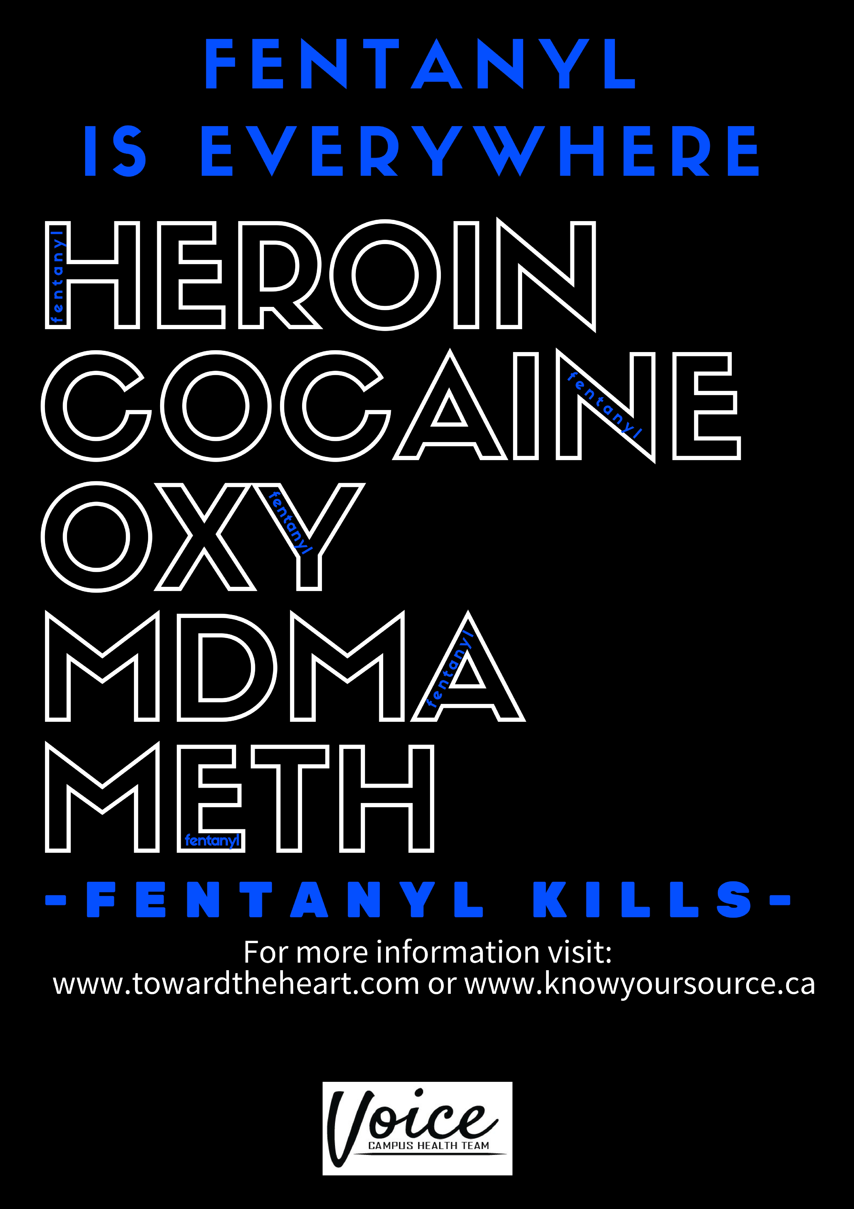
Prevention Campaign
Salt Challenge Tabling
Poster campaign
Naloxone training and kit education sessions

Slide 10
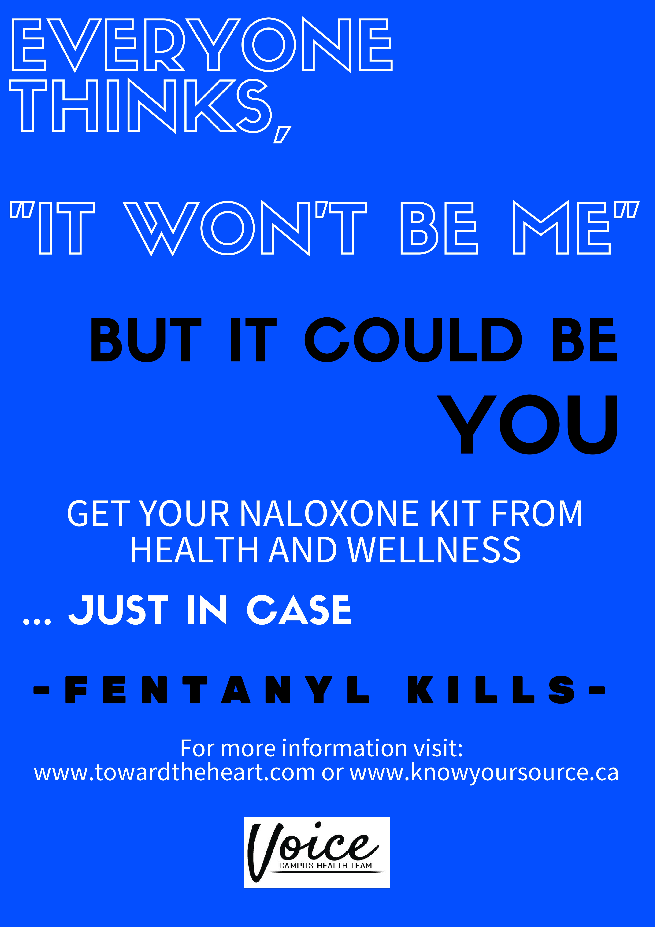
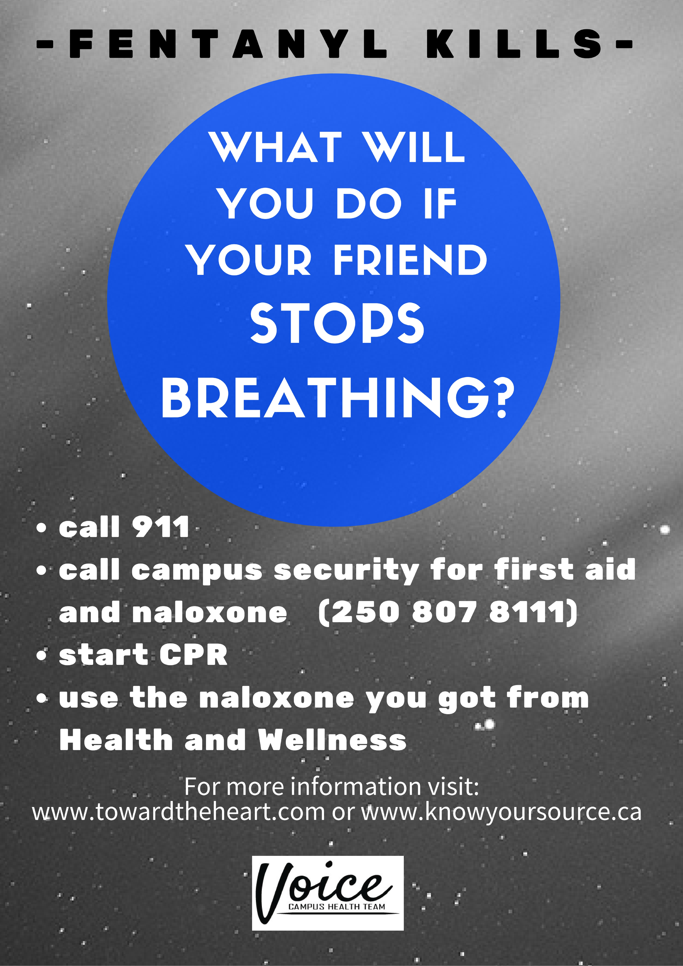

Slide 11
Harm Reduction Strategies
Naloxone and other harm reduction supplies being given to any drug users through Health and Wellness. As of today five kits have been disbursed and 45 more have been ordered.
Comprehensive list of where else you can get kits being developed
Security leads being trained in use
As of yesterday ALL first responders (RCMP, Fire, etc) may now administer naloxone.

Slide 12

A Medical Amnesty Approach to
Drug-Related Emergencies
Michelle Thiessen
Clinical Psychology MA Student

Slide 13
Students are reluctant to seek medical attention for themselves or others in potential drug-related emergencies
Unsure if an intoxicated person is sick enough to warrant medical attention
Concerned about potential judicial consequences to themselves, the intoxicated individual, and/or the residence where the consumption took place

Slide 14
A number of universities have implemented a
Medical Amnesty Program/Good Samaritan Policy
Amnesty from disciplinary actions for the person experiencing the medical emergency, the person(s) who notify authorities, and any other bystanders, as a maximum effort to promote fast action responses
Amnesty from disciplinary action for all violation of all substance policies, not just alcohol policy violations
Applies educational sanctions vs. disciplinary sanctions

Slide 15
UBC Okanagan’s Current Discipline for Non-Academic Misconduct: Student Code of Conduct
(k) Relocation or exclusion from residence
(m) Suspension from the University
(n) Expulsion from the University

Slide 16
Urge UBC to issue a temporary amnesty for all drug-related emergencies

Slide 17
We are in unprecedented territory
What can we do to continue to be leaders in supporting our community and reducing risk for our students?
How can we increase naloxone uptake on our campus?
What else can we do to creatively reduce risk for our students?

